Slide 1




JavaScript for Front-End
Course Overview
JavaScript
SoftUni Team
Technical Trainers
Software University
http://softuni.bg

Slide 2
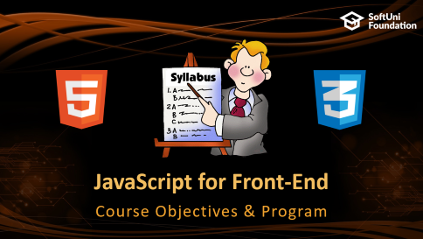



Table of Contents

Slide 3
Have a Question?
sli.do #front-end

Slide 4







SoftUni Diamond Partners

Slide 5



JavaScript for Front-End
Course Objectives & Program

Slide 6
JavaScript – Course Topics
Introduction to Bootstrap – What is Bootstrap. Bootstrap Components. Bootstrap Grid System.
CSS Preprocessors (SASS, LESS) – SASS and LESS Overview. Nesting, Variables, Mixins, Selector Inheritance
Introduction to JavaScript – Basic Syntax, Arrays, Functions, Objects, Maps, Sets, JSON
Introduction to JQuery & DOM – JQuery, Selectors, DOM Manipulation, Events…
JS Libraries – Libraries for Notifications, Stickies, Sliders etc.

Slide 7

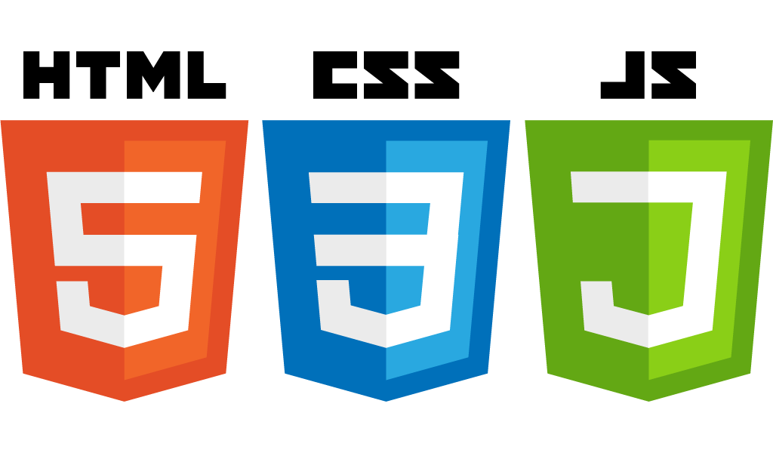
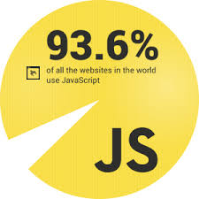
JavaScript – Course Topics (2)
Introduction to AJAX – JQuery Ajax Concept, Requests, HTTP
Exam Preparation
Teamwork Public Defenses
Practical Exam

Slide 8

The Trainers Team

Slide 9

Trainers Team
Ivaylo Dimitrov
4+ years experience in the IT (HTML, CSS, JavaScript, C#, SQL,
Windows Server)
Student with excellent grades in Software University
Technical Trainer in Software University

Slide 10
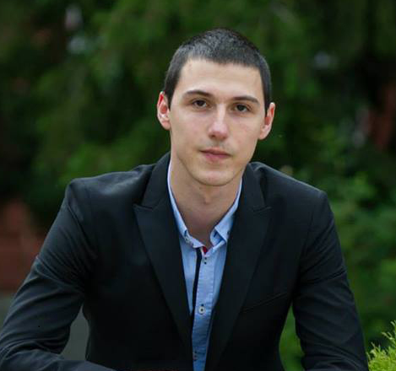
Trainers Team
Georgi Genov
Started as a Freelance Web Developer.
Currently a Team Leader of a PHP Team
Various personal projects
Strong skills in PHP, HTML & CSS, JavaScript, SASS, LESS…
Personal Blog: www.ggenov.eu

Slide 11

JavaScript for Front-End: More Details
Duration, Languages, Technologies

Slide 12


Training Duration – JavaScript for Front-End
Lessons: ~ 35 hours (onsite + YouTube videos)
Practical exercises (in class): ~ 40 hours
Homework: ~ 30 hours
Exam preparation: 8 hours
Exam: 6 hours
Schedule: 31 October – 03 December 2017
Exam date: 03 December 2017

Slide 13



Why English?
Why the slides are in English?
English is the native language of the software engineers
Specific terminology should be in English
Translations are inaccurate and funny
Just learn English!
No excuses

Slide 14



Learn to Search in Internet & Find Solutions!
The course assignments require to search in Internet
This is an important part of the learning process
Some exercises intentionally have no hints
Learn to find solutions!
Software development includes everyday searching and learning
No excuses, just learn to study!
Developers learn new technologies, tools, languages every day!

Slide 15

Evaluation

Slide 16


Scoring System for the Course
Mandatory:
Final exam – 90%
Homework submissions – 10%
Bonuses:
Teamwork – 10% bonus
Presence in class – 5% bonus
Forum activity – bonus up to 5%

Slide 17


JavaScript for Front-End Exam
Practical JavaScript application exam
1 application for 6 hours
Analyze the given Skeleton
Implement some more HTML & CSS
Make Simple requests to a Mobile Back-End
Implement Data Rendering on an HTML Page
Implement User Authorization

Slide 18

Homework Assignments
Doing your homework is very important!
HTML and CSS can only be learned through a lot of practice!
You should write code every day!
Each lesson is followed by a few exercises
Try to solve them in class
The rest are your homework
Homework assignments are due in 6 days after each lesson

Slide 19










Resources
What We Need Additionally?

Slide 20



JavaScript Course Web Site, Forum and FB Group
Official web site:
Official discussion forum:
Official Facebook groups:
https://softuni.bg/courses/javascript-for-front-end
https://softuni.bg/forum/categories/68/web-basics
https://www.facebook.com/groups/front.end.sept.2017/

Slide 21

The Front-End Development Slides and Videos
All lecture slides, videos, homework assignments, projects and other resources are open content, available for free
Visit the course web site to access the course resources

Slide 22

Software University Learning System (SULS)
Software University Learning System (SULS)
www.softuni.bg
Important resource for students
Homework submissions
Homework check-up
Exams and results
Reports about your progress
…

Slide 23





Recommended Software
You will need a good IDE like:
WebStorm
Visual Studio Code
Brackets
Microsoft Visual Studio

Slide 24


Summary
The “JavaScript for Front-End" course teaches
The first steps in JavaScript
Training curriculum
Basic Syntax, JSON, Objects, Libraries etc.
Practical exam
1 application for 6 hours
Learning resources
Slides, videos, software, books, forum

Slide 25
JavaScript for Front-End – Course Overview
https://softuni.bg/courses/javascript-for-front-end

Slide 26
License
This course (slides, examples, demos, videos, homework, etc.) is licensed under the "Creative Commons Attribution-NonCommercial-ShareAlike 4.0 International" license

Slide 27





Trainings @ Software University (SoftUni)
Software University – High-Quality Education, Profession and Job for Software Developers
softuni.bg
Software University Foundation
http://softuni.foundation/
Software University @ Facebook
facebook.com/SoftwareUniversity
Software University Forums
forum.softuni.bg

